Slide 1
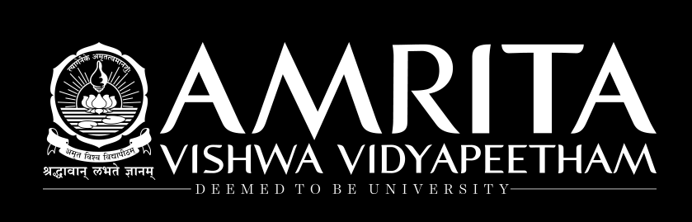
Model Evaluation –Overfitting

Slide 2
Overview
Overfitting vs Underfitting
Underfitting to Overfitting in Prediction(Regression)
Underfitting to Overfitting in Classification
Impact of Overfitting on Performance
Approaches to reduce Overfitting
Summary

Slide 3
What is Overfitting?
ML models can generalize and produce relationships (models) between predictor where the ‘fit’ maybe excellent.
highly complex explanations of variables and response variable
However, when used with new unseen data, models of great complexity may not do so well!
Overfitting happens when a model learns the details and also noise in the training data to the extent that it negatively impacts the performance of the model on new data. (excellent performance on training, but poor generalization on new data).
Overfitting produces poor predictive performance – past a certain point, the error rate on new data starts to increase
Conversely, Underfitting occurs when the model fails to capture or generalize the underlying pattern in the data, mostly due to over-simplicity of the model. (poor performance on training as well as poor generalization on new data)

Slide 4
Bias and Variance
Bias is simply defined as the inability of the model because of that there is some difference or error occurring between the model’s predicted value and the actual value. These differences between actual or expected values and the predicted values are known as error or bias error or error due to bias. Bias is a systematic error that occurs due to wrong assumptions in the machine learning process.
Variance is the amount by which the performance of a predictive model changes when it is trained on different subsets of the training data. More specifically, variance is the variability of the model that how much it is sensitive to another subset of the training dataset. i.e. how much it can adjust on the new subset of the training dataset.
There can be four combinations between bias and variance.
High Bias, Low Variance: A model with high bias and low variance is said to be underfitting.
High Variance, Low Bias: A model with high variance and low bias is said to be overfitting.
High-Bias, High-Variance: A model has both high bias and high variance, which means that the model is not able to capture the underlying patterns in the data (high bias) and is also too sensitive to changes in the training data (high variance). As a result, the model will produce inconsistent and inaccurate predictions on average.
Low Bias, Low Variance: A model that has low bias and low variance means that the model is able to capture the underlying patterns in the data (low bias) and is not too sensitive to changes in the training data (low variance). This is the ideal scenario for a machine learning model

Slide 5
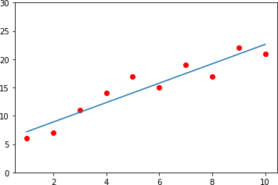
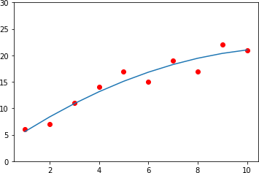
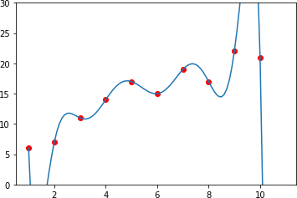
Underfitting to Overfitting – Prediction (Regression)
Given a dataset, where
X = [1, 2, 3, 4, 5, 6, 7, 8, 9, 10] and
y = [6, 7, 11, 14, 17, 15, 19, 17, 22, 21]
y
X
Linear Model
X
Quadratic Model
X
Polynomial Model
y = aX + c
y = a₁X + a₂X² + c
y = a₁X+a₂X²+a₃X³+a₄X⁴+a₅X⁵+a₆X⁶+a₇X⁷+a₈X⁸+ a₈X⁸+c
` Zero
Accuracy: 89.5 %
Accuracy: 93%
Accuracy: 99.99%
Error
Simple
Underfitting (High Bias)
Just Fit
Overfitting (High Variance)
Complex

Slide 6
Underfitting to Overfitting – Classification
X₂
X₂
X₂
` Zero Error
X
1
X
1
X₁
Simple
Complex
Underfitting (High Bias)
Just Fit
Overfitting (High Variance)

Slide 7
Impact of Overfitting on Performance
Training Test
Error
Underfitting
Overfitting
Model Complexity

Slide 8
Approaches to reduce Overfitting
Partitioning the available data into Training – Validation – Test partitions and performing Cross Validation
Reducing the number of features used in building the model
Regularization

Slide 9
Summary
Overfitting : excellent performance on training data, but poor generalization on new data. Also known as High Variance
Underfitting : Poor performance on training as well as poor generalization on new data. Also known as High Bias
Complex models with zero error typically end up overfitting
Partitioning of data into Training-Validation-Test partitions for cross validation, reducing number of features, regularization, etc., are some of the techniques to reduce the impact of overfitting

Slide 10
References
https://towardsdatascience.com/overfitting-vs-underfitting-a- complete-example-d05dd7e19765
https://chunml.github.io/ChunML.github.io/tutorial/Underfit-Overfit/
https://machinelearningmastery.com/overfitting-and-underfitting- with-machine-learning-algorithms/
https://keeeto.github.io/blog/bias_variance/

Slide 11
Model Evaluation – Partitioning (Overview)
Partitioning of data : Train – Validation – Test split
Shortcomings of standard partitioning approach
k-fold cross validation
Variations in cross-validation approaches

Slide 12


Partitioning: Train-Test split
How well will our model perform on fresh data, the model has not seen before and how to reduce the scope for overfitting?
Partition the available data into minimum 2 parts or ideally 3 parts
Available Dataset with known values of response variable y and predictor variables X (100%)
Training partition (60%)
Test partition (40%)
Used to develop the models
To evaluate the models on “unseen” data
Training partition (60 %) | Validation (20%) | Test (20%)

Slide 13
Need for a 3rd Partition
When a model is developed using training data, it can overfit the training data and hence the need to assess the performance on ‘unseen’ data, a.k.a. validation partition
Assessing multiple models on the same ‘unseen’ data, can again lead to overfitting on this data (i.e. the validation partition)
Hence the final selected model is applied to the third partition (Test partition) to give an unbiased estimate of its performance on ‘new’ data. Test partition also referred to as ‘Holdout’ set
Note - ML literature typically refers to the 2 partition scenario as Training/Test, whereas some literature refer to them as Training/Validation.

Slide 14
Shortcomings of training, validation and test split
Given the split into only one set of training, validation, test partitions, the performance of our models are highly dependent on the nature of data in those partitions
Thus performance might vary if the split points were different and training and evaluation were on different subsets of data
What if we could do this split into training and validation set multiple times, each time on different subsets of the same data, and then train and evaluate our models each time to look at the average performance of the models across multiple evaluations?

Slide 15
Cross-Validation
Cross validation is a technique used in machine learning to evaluate the performance of a model on unseen data.
It involves dividing the available data into multiple folds or subsets, using one of these folds as a validation set, and training the model on the remaining folds.
This process is repeated multiple times, each time using a different fold as the validation set.
Finally, the results from each validation step are averaged to produce a more robust estimate of the model’s performance.
Cross validation is an important step in the machine learning process and helps to ensure that the model selected for deployment is robust and generalizes well to new data.

Slide 16
Why cross-validation?
The main purpose of cross validation is to prevent overfitting, which occurs when a model is trained too well on the training data and performs poorly on new, unseen data.
By evaluating the model on multiple validation sets, cross validation provides a more realistic estimate of the model’s generalization performance, i.e., its ability to perform well on new, unseen data.

Slide 17
Types of Cross-Validation
There are several types of cross validation techniques
k-fold cross-validation
Stratified Cross-Validation
Leave-One-Out Cross-Validation(LOOCV)
Holdout validation
The choice of technique depends on the size and nature of the data, as well as the specific requirements of the modeling problem.

Slide 18
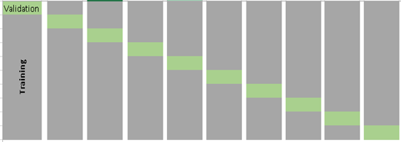
k-fold Cross Validation
An alternative to data partitioning, esp. when the number of records in the dataset is small
Training
Validation/Test
Partitioning the data into “folds,” or non- overlapping (disjoint) sub-samples.
If we choose k = 10 folds, meaning that the data are randomly partitioned into 10 equal parts, where each fold has 10% of the observations.
Ref: https://www.analyticsvidhya.com/blog/2018/05/improve-model-performance-cross-validation-in-python-r/

Slide 19
k-fold Cross Validation
Training
Validation/Test
Randomly split your entire dataset of ‘n’ instances into k ‘folds’ (each of size n/k)
For each k-fold in your dataset, build a model on k – 1 folds of the dataset. Then, test the model to check the effectiveness for k^{th} fold
Record the error you see on each of the predictions
Repeat this until each of the k-folds has served as the test set
The average of your k recorded errors is called the cross validation error and will serve as your performance metric for the model
Average of k test performances Or
Best of k models
Ref: https://www.analyticsvidhya.com/blog/2018/05/improve-model-performance-cross-validation-in-python-r/

Slide 20
How to choose value of k in ‘k-fold cross validation’
On small datasets, lower value of k could increase bias and hence not desirable (similar to the use of traditional partitions – train/validation/test)
Higher values of k reduces bias, but increases scope for variability
Special case of k = n, referred to as ‘Leave one out cross validation (LOOCV)’or n-fold cross validation (where n = number of training samples)
Reserve only one data point from the available dataset, and train the model on the rest of the data. This process iterates for each data point and hence k=n.
Computationally expensive
Ref: https://www.analyticsvidhya.com/blog/2018/05/improve-model-performance-cross-validation-in-python-r/

Slide 21
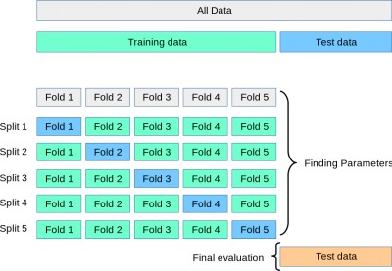
k-fold Cross-Validation for Parameter Tuning
Sometimes cross validation is built into ML algorithm implementation, with the
results of the cross validation used for choosing the algorithm’s parameters
Image Source: https://towardsdatascience.com/cross-validation-and-hyperparameter-tuning-how-to-optimise-your-machine-learning-model-13f005af9d7d

Slide 22
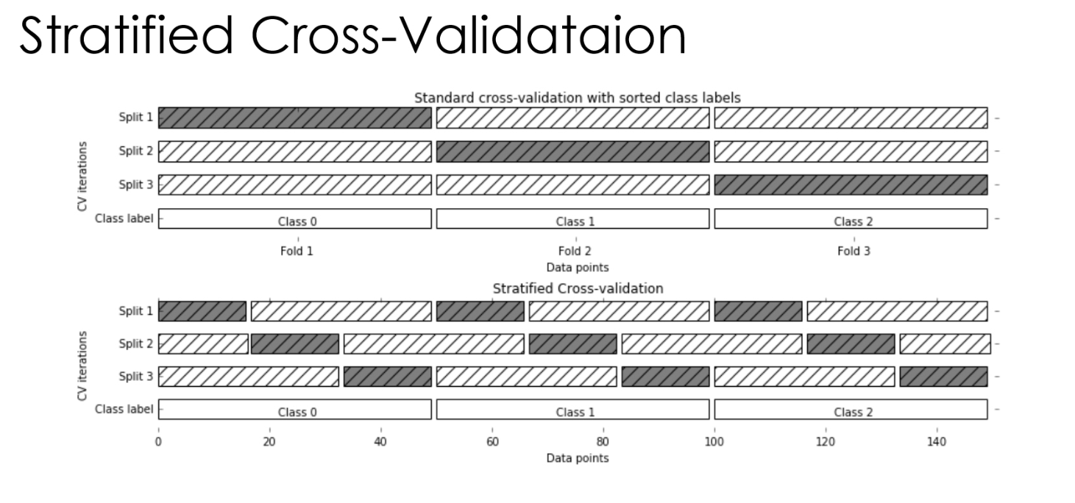

Slide 23
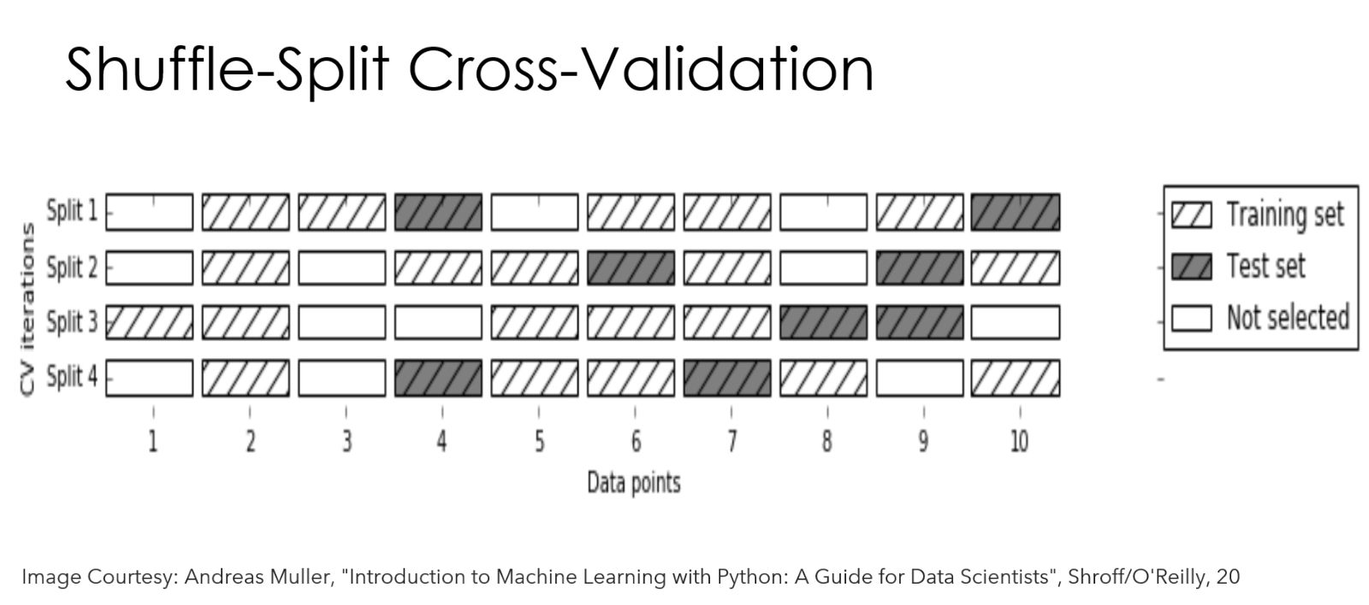

Slide 24
Summary
Partitioning available data into Training-Validation-Test sets, where multiple models are developed using the Training set, and evaluated against the Validation set, and the best model is re-evaluated against the test set before being applied on fresh data
Performance might vary if the split points were different and training and evaluation were on different subsets of the same dataset.
k-fold cross validation involves partitioning data into “folds,” or non-overlapping (disjoint) sub-samples so as to build the model on k – 1 folds of the dataset and then test the model on the k^{th} fold.
k-fold cross validation is also used for parameter tuning to arrive at the optimal values of parameters of a model before applying it on test data

Slide 25
References
https://towardsdatascience.com/train-test-split-and-cross-validation-in- python-80b61beca4b6
https://www.analyticsvidhya.com/blog/2018/05/improve-model- performance-cross-validation-in-python-r/
https://machinelearningmastery.com/k-fold-cross-validation/
https://towardsdatascience.com/cross-validation-and-hyperparameter- tuning-how-to-optimise-your-machine-learning-model-13f005af9d7d

